Slide 1
Fertilizer Shop Find
Team-20 (AIML-B)
22EG107B26
22EG107B48
22EG107B65

Slide 2
Description:
The Fertilizer Finder is a web application designed to help farmers and gardeners locate nearby fertilizer shops and agricultural supply stores. Built using the MEAN stack (MongoDB, Express.js, Angular, Node.js), the website provides users with essential features such as shop reviews, locations, product offerings (seeds, fertilizers, pesticides), and opening hours.
Objective: To streamline the process for users to find and review fertilizer shops in their area, enhancing the accessibility of quality agricultural products and services.

Slide 3
Key Features:
Home Page: Displays a list of shops with ratings, distance from the user, and available products.
About Page: Provides details on the mission of the website, promoting its focus on agriculture and supporting farmers.
Review Page: Allows users to submit and view reviews for each shop, helping others make informed decisions.
Location Details: Integrates Google Maps API to showcase shop locations, including additional details like opening hours and available services.

Slide 4
Technologies Used:
MongoDB: Database for storing shop details, reviews, and user data.
Express.js: Backend framework for handling API requests.
Angular: Frontend framework for building a dynamic and responsive user interface.
Node.js: Runtime environment for the backend server.
Google Maps API: For embedding maps and displaying shop locations.

Slide 5
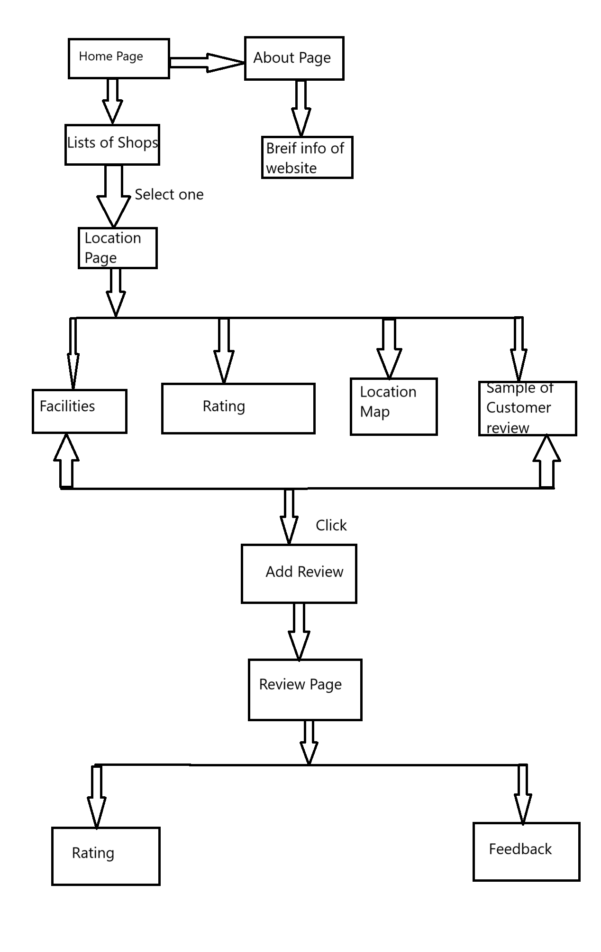
Flow Chart:

Slide 6
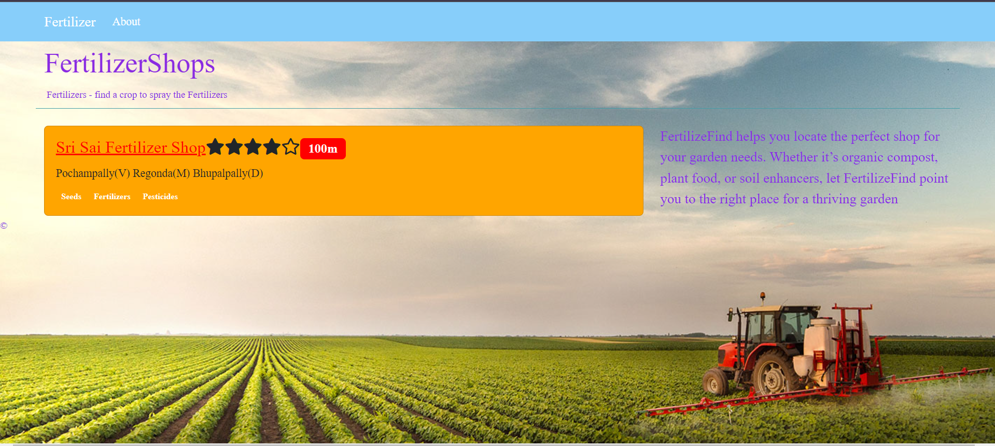
Home Page:

Slide 7
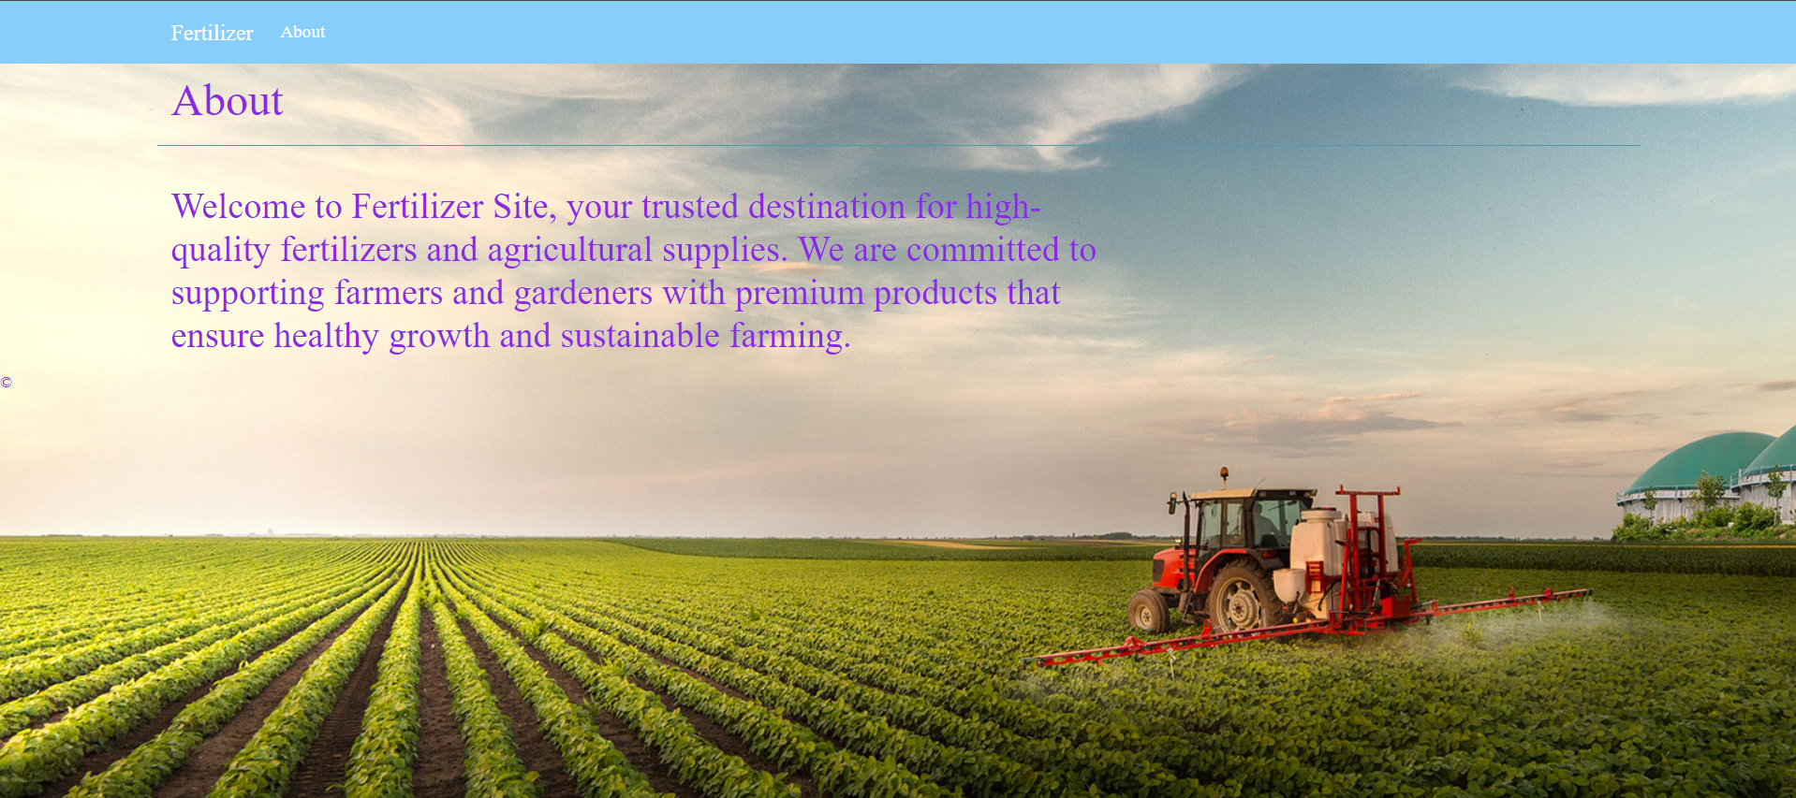
About Page:

Slide 8
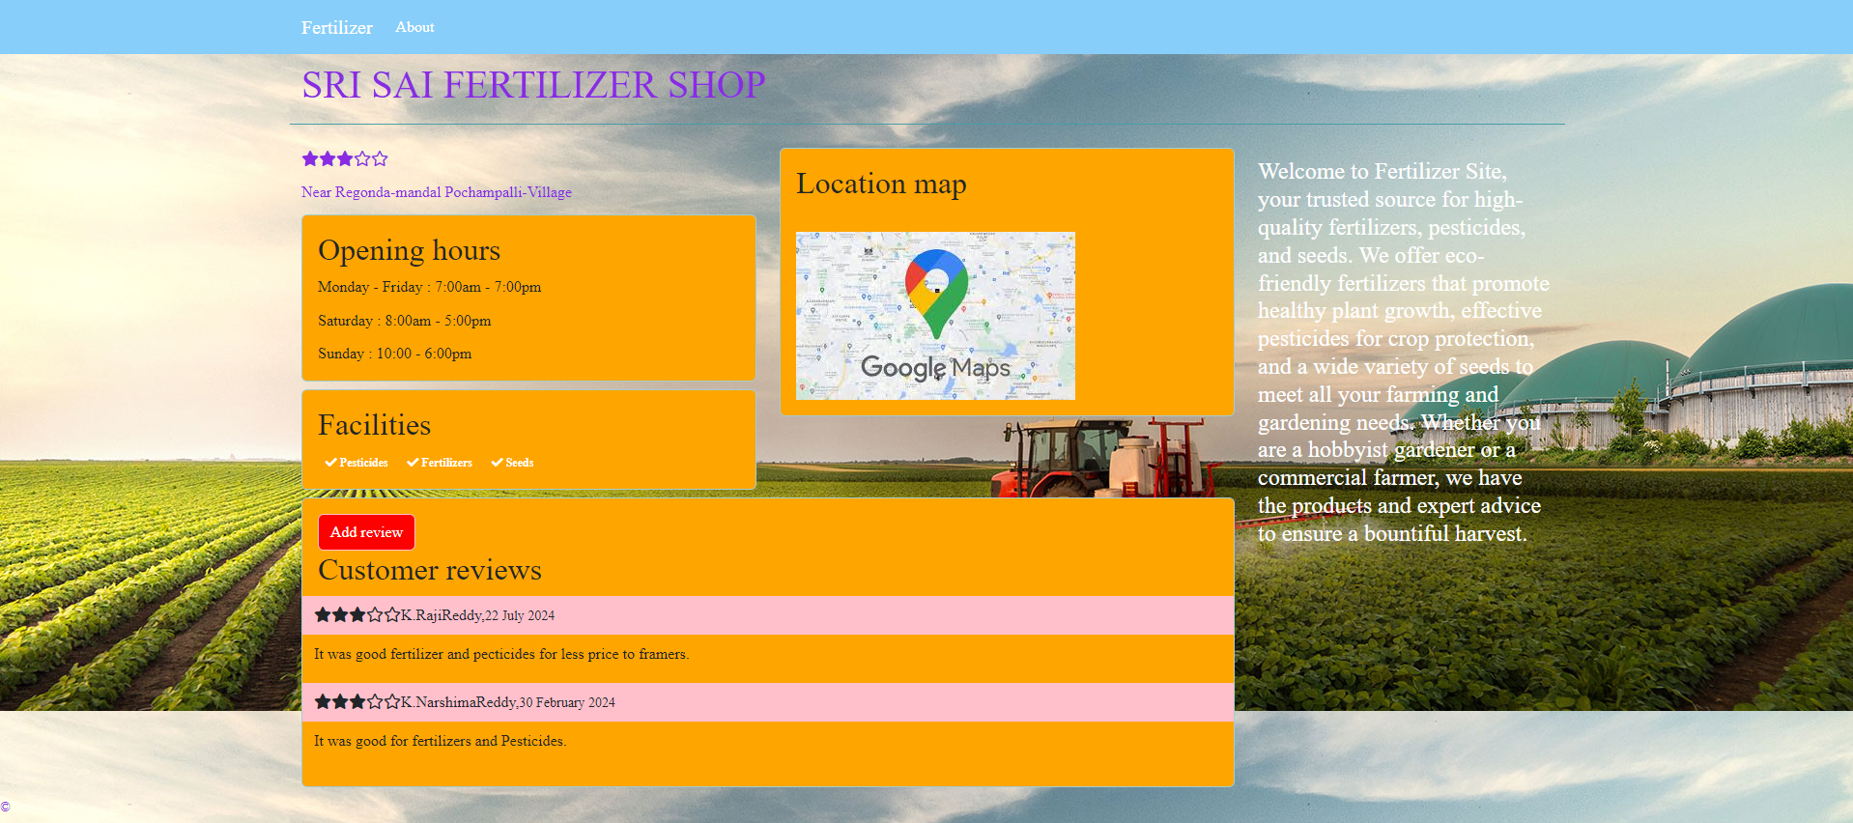
Location Page:

Slide 9
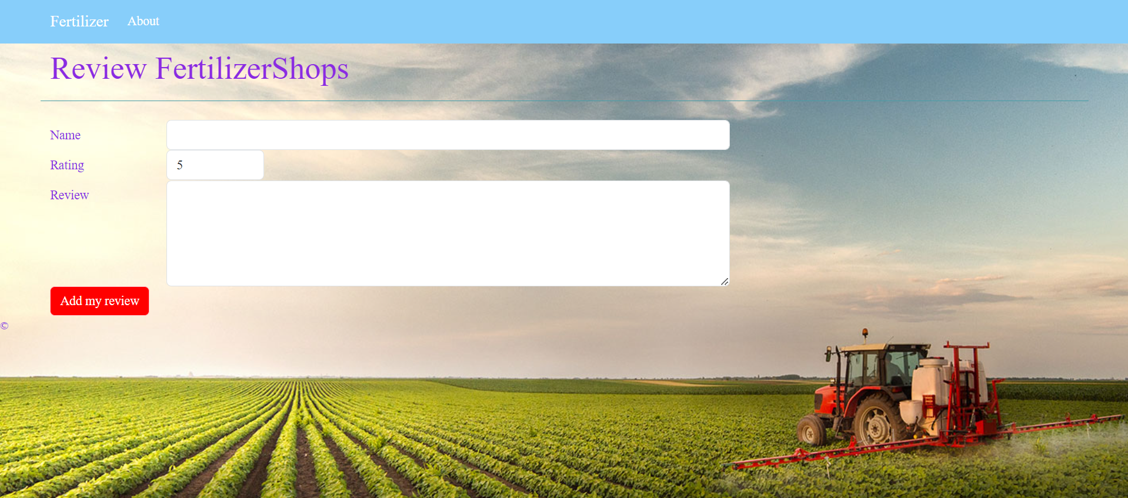
Review Page:

Slide 10
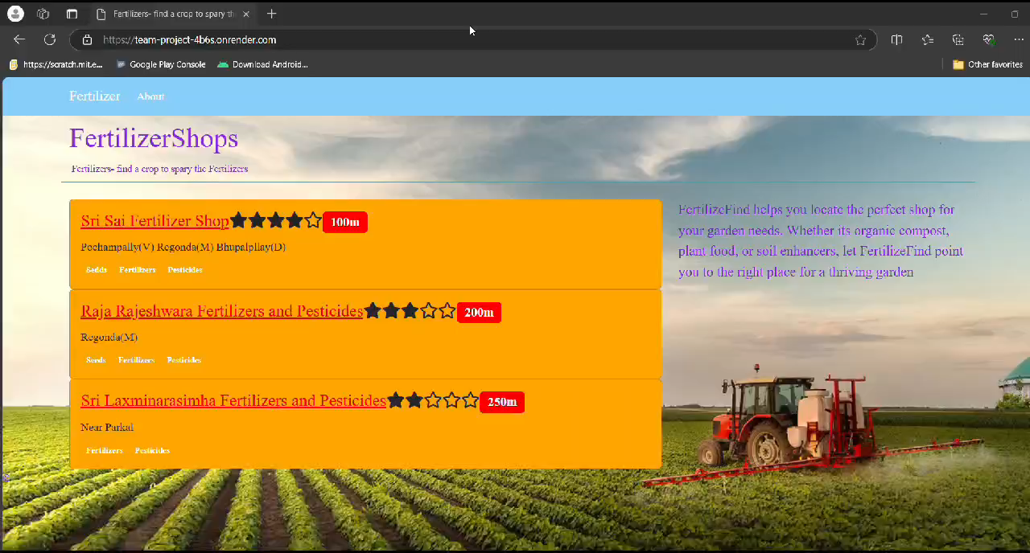
Demo of The Project:

Slide 11
Links:
Project Link:
https://team-project-1-t7t6.onrender.com/
GitHub Link: https://github.com/Harshavardhanreddy2004/Team-Project.git

Slide 12
Thank You

